Slide 1

CareerSathi
Team AlgoCrunchers

Slide 2

AI-Driven Skill Enhancement & Job Connect Agent – Career Saathi
Developed an AI-powered agent ecosystem that guides Indian job seekers in identifying skill gaps, recommending personalized training, and matching them with relevant job opportunities. Targeting both entry-level and vocational segments, this agent evolves with the user’s journey, providing continuous career support.
Functional/Technical Requirements:
Career Guidance Orchestrator: Central AI agent that coordinates all sub-agents and user interaction.
Skill Assessment Agent: Analyzes user aptitude, experience, and interests to determine career readiness.
Demand Analysis Agent: Fetches real-time job market data to identify in-demand skills by role and location.
Training Resource Agent: Recommends relevant courses, certifications, and local government programs.
Job Matching Agent: Finds tailored job listings from portals based on user profile and preferences.
NonFunctional/NonTechnical Requirements:
User Experience: Intuitive chatbot/mobile/web interface for real-time guidance.
Automation: Integrated with CrewAI and n8n for seamless task execution and API calls.
Deployment Ready: Designed for Fetch.ai Agentverse using FetchAI SDK.
Monetization: Includes subscription features, partner commissions, and certification fees.

Slide 3

Recommendation
System
Dashboard
Skill Gap Analysis
Crew-AI
Integration
Features
Training Resource Aggregator
Mobile-First Interface
Resume & Interview Assistant
Real-Time Job Matching

Slide 4
Recommendations
System
Uses AI to analyze user goals, skills, and preferences.
Recommends jobs and training opportunities tailored to the profile.
Continuously adapts suggestions based on user interaction.
Powered by OpenAI + CrewAI logic for contextual understanding.
Features

Slide 5
SkillGap Analysis
Evaluates current skillset against desired job roles.
Highlights missing or underdeveloped skills.
Provides clear action steps to bridge the gap.
Uses NLP-based comparison between job descriptions and profiles.
Features

Slide 6
Training Resource Aggregator
Features
Pulls top online courses (MOOCs, gov. portals, certifications).
Suggests learning paths based on industry demand.
Filters by cost, duration, and skill level.
Partners with platforms like Coursera, NPTEL, and UpGrad.

Slide 7
Features
Resume & Interview Assistant
Resume & Interview Assistant
Generates ATS-friendly resumes using AI templates.
Offers mock interview simulations with feedback.
Provides industry-specific Q&A preparation.
Helps craft LinkedIn summaries and cover letters.

Slide 8
Features
Searches job portals using live APIs or custom scraping.
Filters by location, salary expectations, and job type.
Sends real-time updates or notifications via bot/app.
Prioritizes listings based on fit score.
Real-Time Job Matching

Slide 9
Features
Designed for accessibility on Android and iOS.
Simple chatbot-style interaction for inputs and feedback.
Saves user preferences for personalized journeys.
Syncs progress across devices.
Mobile-First Interface

Slide 10
Features
CrewAI Integration
Modularizes the career workflow using goal-driven AI agents (e.g., Skill Assessor, Job Matcher).
Enables seamless task orchestration through multi-agent collaboration.
Supports both sequential and parallel processing of tasks for efficiency.
Easily extendable with new agents for resume building, interview prep, etc.
Crew-AI
Integration

Slide 11
User Progress Dashboard
Central hub to track job applications, completed courses, and skill growth.
Visualizes milestones, learning paths, and agent recommendations.
Offers personalized insights and nudges for next career steps.
Encourages goal setting and achievement through gamified elements.
Features

Slide 12
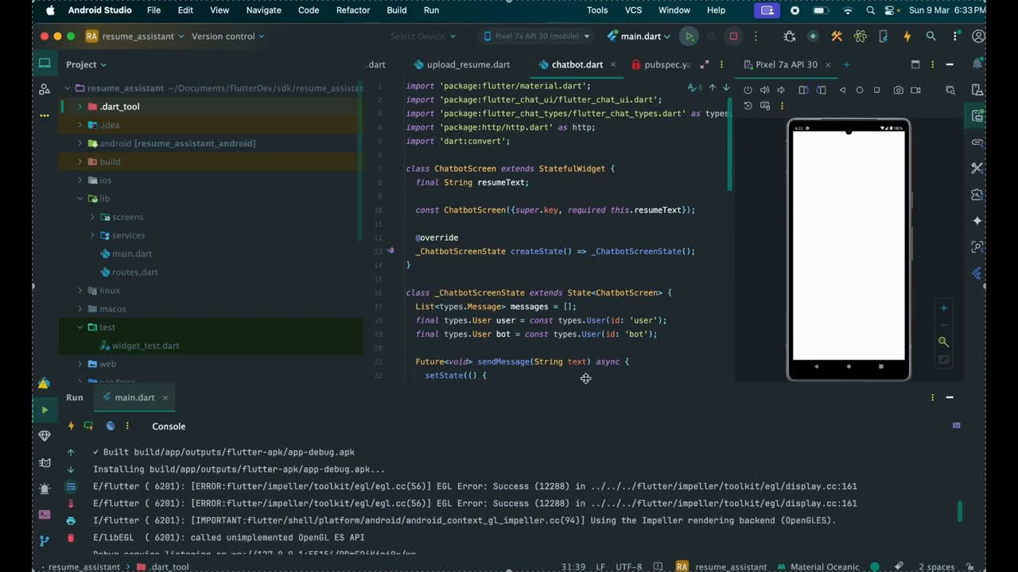

Slide 13


Thank You
For Your Attention

